Slide 1
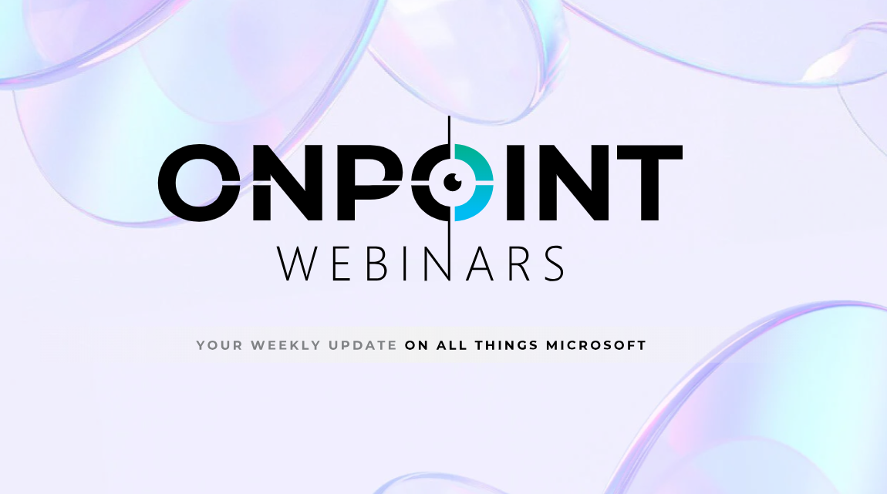


Slide 2
FY25 Reflections & What’s New in 2026
Paul Randazzo & Zach Dickson

Slide 3
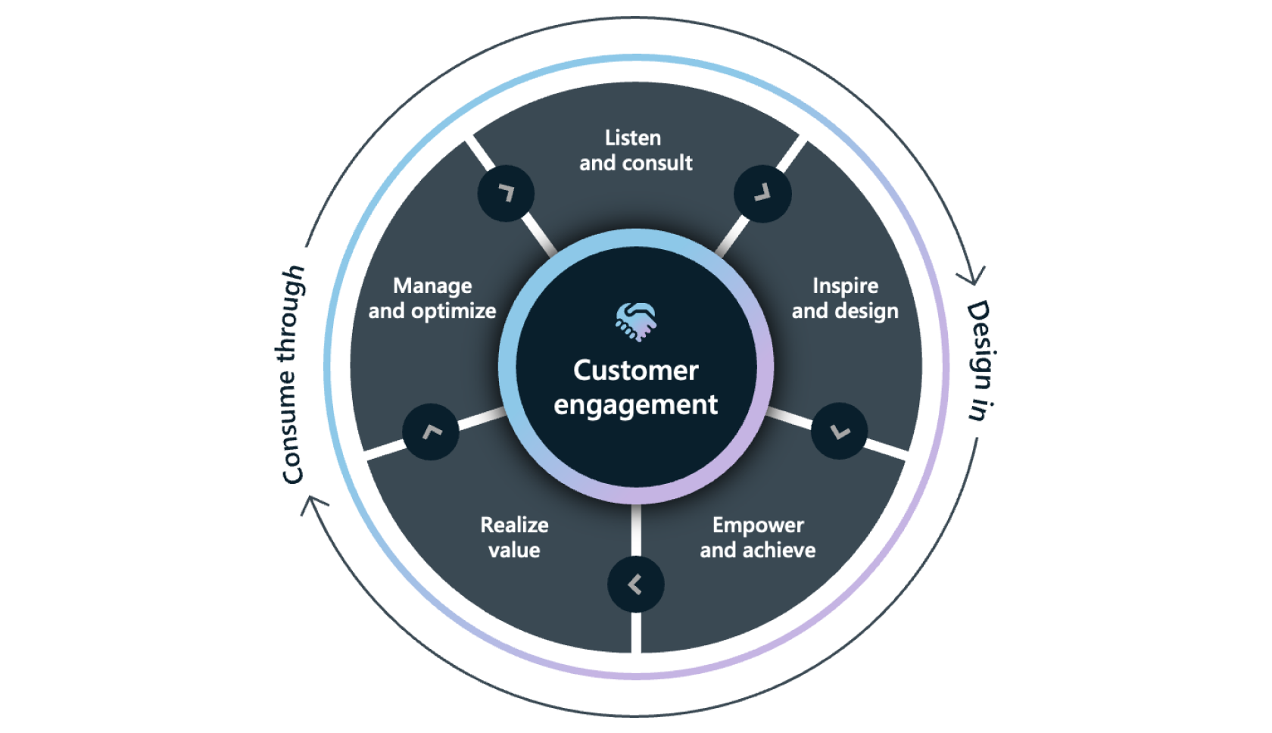
Why 2025 was a transition year
CSP Partners Continuing to Move from Transactional -> Value Led
Licensing retained customers, services drove differentiation & created lifecycle stickiness
Margin Pressure Continued & Services Became Essential
Where the most successful CSP partners made money:
Attach Services at renewal & upgrade events
Managed Services tied to M365, Azure, Security & Copilot
Packaged Outcomes (Readiness, Adoption, Governance, AI)
Where did you really make money in 2025 –
licenses, services or outcomes?
Notes:
ZD : “Over the past year, one theme has been consistent across the channel: margin pressure hasn’t gone away. In fact, for many CSP partners, it’s intensified. Licensing alone is no longer where growth comes from. The partners who continued to win were the ones who shifted their motion from reselling to value-led services.
What we saw from the most successful CSP partners is that they treated every renewal and upgrade event as a services opportunity. Rather than simply processing transactions, they attached assessments, readiness workshops, migration services, security hardening, and Copilot enablement. These partners turned routine subscription conversations into high‑value engagements.
Second, the strongest performers leaned heavily into managed services. They built predictable, recurring revenue streams tied to M365, Azure, Security, and increasingly Copilot. Customers aren’t just buying a product anymore—they need ongoing governance, management, monitoring, and optimisation. Partners who offered these ‘always-on’ services increased stickiness while reducing revenue volatility.
And third, partners that packaged their expertise into outcome‑based offerings saw the highest margins. Things like adoption programs, governance frameworks, AI readiness packages, and structured Copilot rollouts. These weren’t sold as hours—they were sold as solutions with clear business outcomes. That’s where partners saw the strongest profitability.
So the big takeaway is simple: as margin pressure continued, services became essential—not optional. The partners who wrapped services around every stage of the customer lifecycle, from readiness to adoption to ongoing management, were the ones who protected margin and unlocked new growth.”

Slide 4
Customer Buying Behaviour Changed
Customers became more:
Cost Conscious – Every AI investment needed a clear ROI narrative
Focused on Security Consolidation
Use-Case Driven with AI – Show me where this helps my people work differently?
AI reality in 2025:
Copilot pilots everywhere
Early adoption driven by curiosity, not confidence
Governance, readiness and change management became gating factors
What won deals?
Partners who could answer “Where will my people save time in week 1?”
Security and Governance handled before AI rollout
Adoption and Change baked into the offer
Defined ROI metrics
Notes:
“In 2025, AI moved from hype to hands‑on experimentation for almost every partner & ustomer we worked with. Copilot pilots were everywhere—from frontline teams to executive assistants. But what was interesting is that early adoption wasn’t driven by confidence or a clear plan. It was driven by curiosity. Customers wanted to ‘try Copilot’ long before they understood how to operationalise it.
And that’s where deployments started to hit friction. Organisations quickly realised that governance, readiness, and change management weren’t ‘nice to haves’—they were the gating factors. IT leaders wanted reassurance around data exposure, licensing clarity, security posture, and who should even get Copilot first. Without those foundations, pilots stalled, and value remained theoretical.
So what cid we see that actually won deals in this environment? The partners who could answer one simple question:
“Where will my people save time in week one?”
That level of specificity cut through the noise. Customers didn’t want abstract benefits—they wanted concrete, role-based time savings and real use cases.
The partners who moved fastest were the ones who handled security and governance upfront, before a single Copilot license was deployed. They brought frameworks, assessments, and best practices that made customers feel safe moving forward.
They also baked adoption and change management into the offer, recognising that AI success isn’t a technical project—it’s a behaviour shift. Partners who included enablement, role-based training, champions programs, and usage insights closed more opportunities and retained them longer.
And finally, the deals were won with defined ROI metrics. Partners who could tie Copilot to measurable outcomes—like hours saved, reduced manual workloads, or accelerated content creation—helped customers justify investment with confidence.
So in 2025, the CSP partners who won weren’t just selling AI. They were selling clarity, safety, adoption, and measurable outcomes. And that made all the difference.”

Slide 5
Microsoft Partner Expectations Increased
Microsoft Raised the Bar for CSP Partner Participation
Higher Standard In:
Security – Mandatory security controls to transact CSP (MFA Requirements, Minimum Secure Score)
Compliance – CSP authorisation validated annually
Customer Success – Incentives aligned to usage, adoption and solution outcomes
More Emphasis On:
Specialisations & Designations – Depth in Solution Areas
Demonstrated Customer Impact – Measured Adoption, Security Posture and Business Outcomes

Slide 6
What’s Coming in 2026?
In the New CSP Reality, Partners that will outperform:
Simplify
Reduce platform, security and AI complexity for customers (and for yourself)
Standardise
Deliver CSP, Security and AI outcomes the same way, every time
Productise
Turn expertise into repeatable, outcome-led CSP offers at key life-cycle moments.
Notes:
“In the new CSP environment, the partners who outperform are the ones who can take complexity out of the customer experience. First, they simplify. Customers are overwhelmed by platform choices, security requirements, and now AI capabilities. The winning partners reduce that noise—streamlining environments, clarifying decisions, and making Microsoft cloud, security, and Copilot feel manageable. And importantly, they simplify internally too, so their own teams can deliver consistently.
Second, they standardise. The best-performing partners aren’t reinventing the wheel every time. They deliver CSP, Security, and AI outcomes the same way, every time—using repeatable frameworks, consistent delivery motions, and predefined success measures. Standardisation improves quality, reduces delivery cost, and accelerates time-to-value for customers.
And finally, they productise. Instead of selling hours or ad‑hoc services, they package their expertise into clear, outcome-led offers that align with key life‑cycle moments—renewals, onboarding, security uplift, AI readiness, and Copilot adoption. Productised offers make it easier for customers to buy, easier for partners to scale, and much easier to demonstrate value quickly.
We’re actively trying to achieve all of these things within Dicker Data, and a great example of that is our Immersions Briefings.
We cut out the noise and are focused on the top 3 opportunities across our collective customer base.
We have Secure Productivity for the Biz Basic, or Biz Standard upsell to Biz Prem.
We have Advanced Security, for Defender & Purview add-ons for Biz Prem
And we have the Copilot & Agents Immersion briefing for Copilot Business attach to BP.
We’ve simplified to what is most important to our partners, we’ve standardised our approach to it, and we’ve turned them into weekly sessions that partners can invite their customers along to, to hopefully lead to repeatable outcome-led CSP opportunities for our partners.

Slide 7
CSP Growth Areas to Watch
Security & AI Envisioning Workshops and User Adoption Programs
AI Readiness and Data Foundations
Compliance & Governance
The Partner Opportunity:
Packaged Offers and Bundles (Fixed Scope, Fixed Outcome)
Copilot & Data Readiness Rapid Assessments + Adoption Pilot
Strategy & Envisioning Packages
Packaged Agent Offers (Legal Contract Review Agent, RFP Agent, Sales Proposal Agent)
Adoption & Change Management Offers (Role based training, Usage & Sentiment Reporting, Prompt Libraries) charged per user model
Copilot Managed Service (Monthly Services – Usage and analytics, new feature enablement, governance updates)
Notes:
P2P -

Slide 8
Cloud Optimisation and Cost Management
FinOps Becoming Renewal-Critical
Customers are asking:
“Are we getting value from what we have bought?”
“Can we optimise further?”
Partner Opportunity:
Ongoing Optimisation Services
Usage, Cost and Value Reporting
FinOps as a managed CSP motion
How Dicker Data Can Help:
Leverage our licensing teams to ensure you’re leading with the most cost-effective licensing commercial offer
Leverage EcpPro to optimise your customers licensing estates

Slide 9
What will Microsoft expect more of in 2026?
Clear Solution Focus, Proven through Specialisations & Designations
Program Utilisation, aligned to Microsoft’s Priorities
Customer Success Discipline will be rewarded via CSP rebates
Strong Security & AI Offerings, delivered responsibly, and at scale
Closer engagement on co-selling in SMB and Mid-Market

Slide 10
How can Dicker Data Help?
Strategic Partnerships:
Chorus Cyber (AU) / DEFEND (NZ) – Microsoft Managed SOC
EcpPro – Automated Billing & FinOps Service Offerings
TechClick – Never Say No to a Customer Opportunity
Solution ConX – Partner to Parter Marketplace – Launching in March 2026
Attend our Upcoming Roadshows to help with packaging and productising Copilot and Security Offerings
Get Your Solution Designation:
Join our NEW Solution Partner Designation Program Starting Next Week
We have exam vouchers to help get your team certified

Slide 11
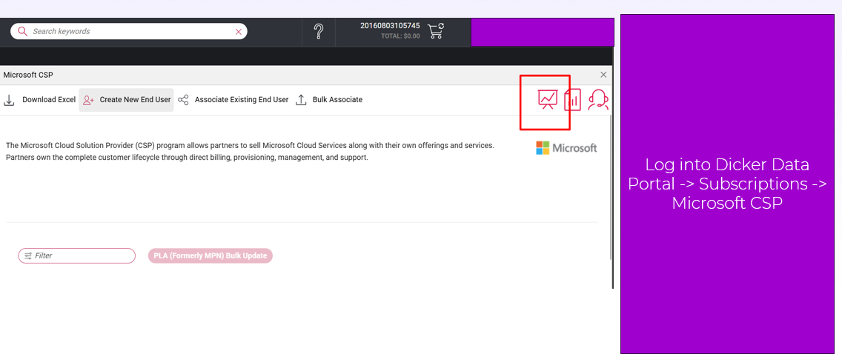
Where to Begin?
NEW: Partner Insights Dashboard

Slide 12
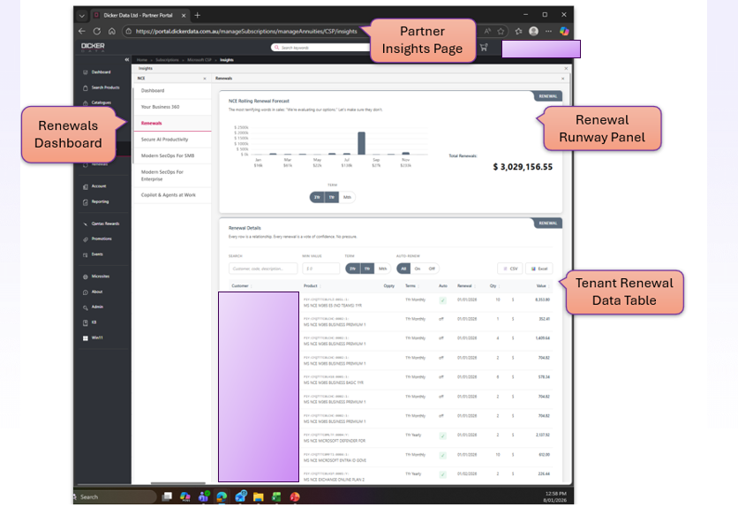

Slide 13
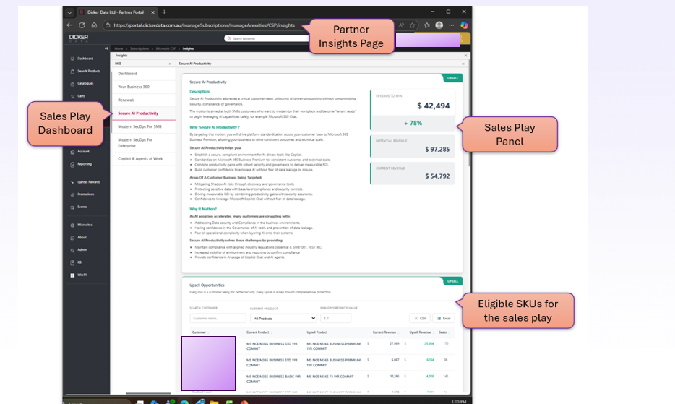

Slide 14
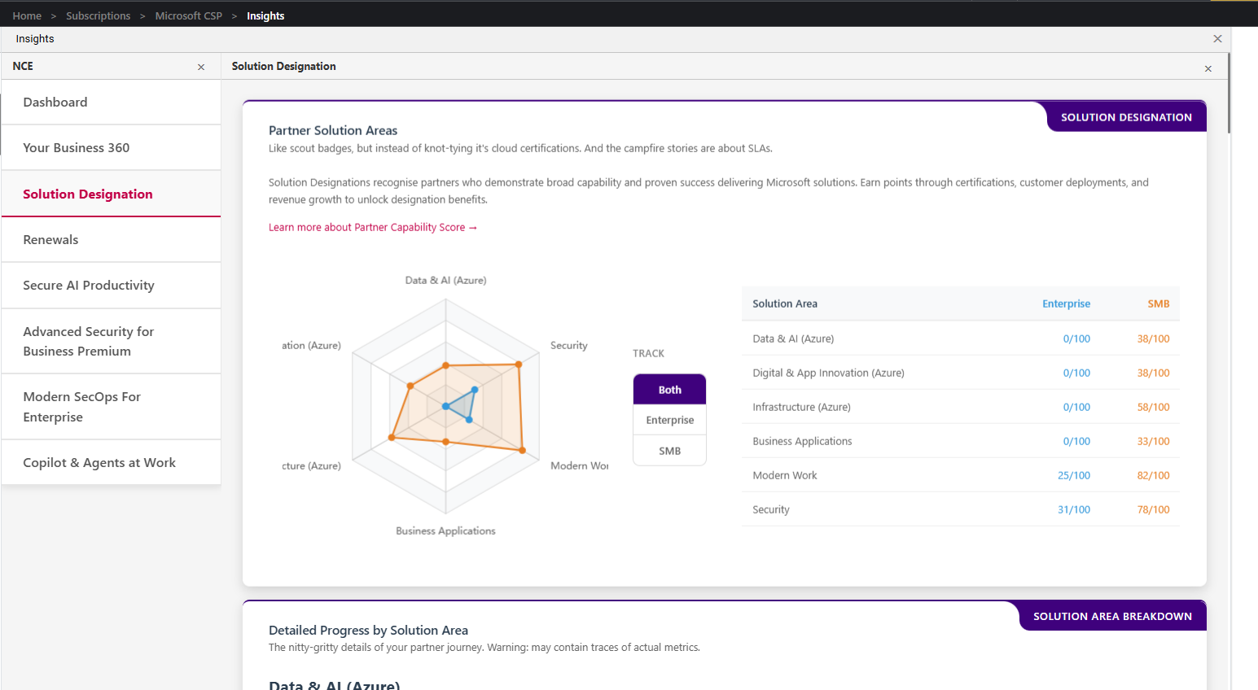

Slide 15

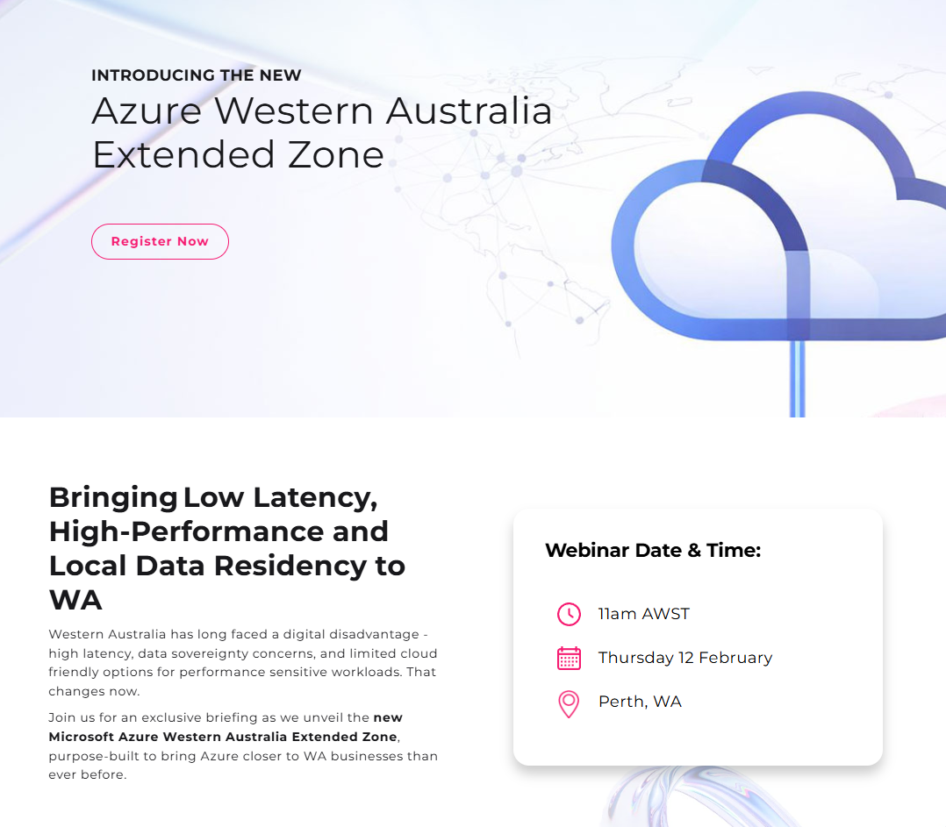
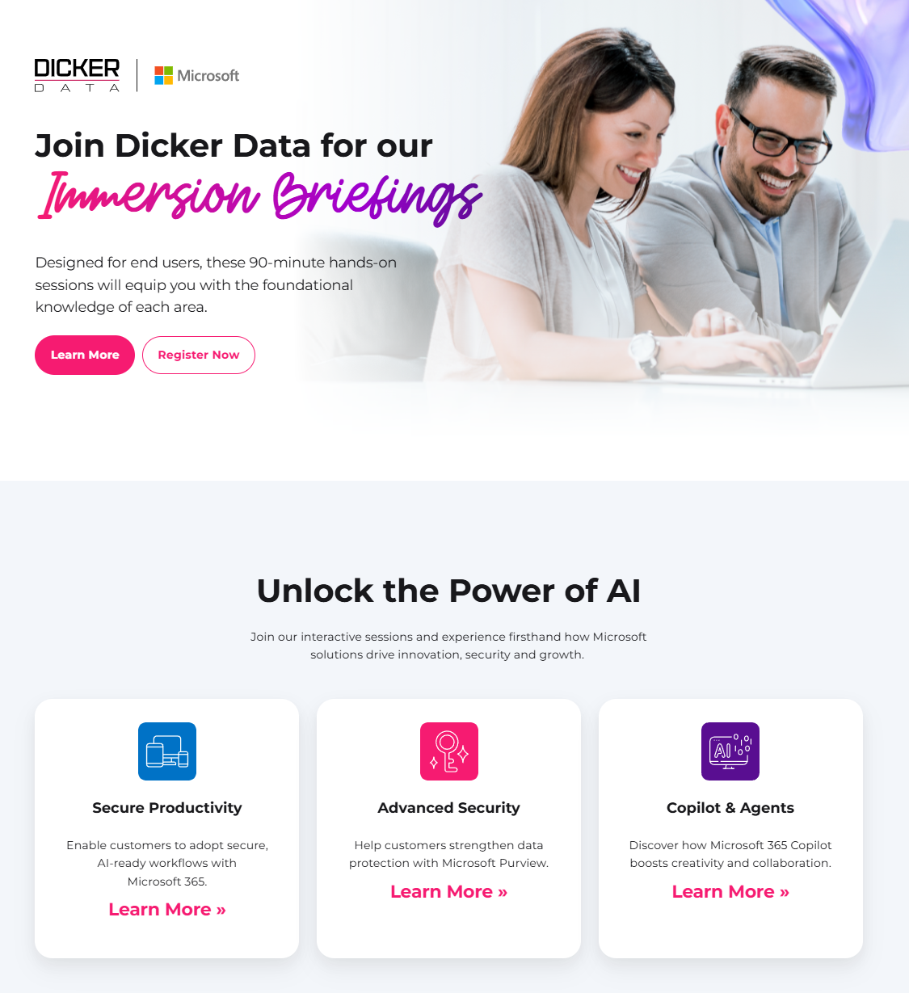

Upcoming Events
DDAU - Partner Skilling Events
DDNZ - Partner Skilling Events
Starts: Thursday & Runs Every Week
11am AEDST, 1pm NZ
FEBRUARY
Syd – 17th
Melb – 19th
Perth – 24th
MARCH
Christ – 9th
Well – 10th
Auck – 12th
Upcoming:
Thursday 12th Feb
11am Perth Time

Slide 16
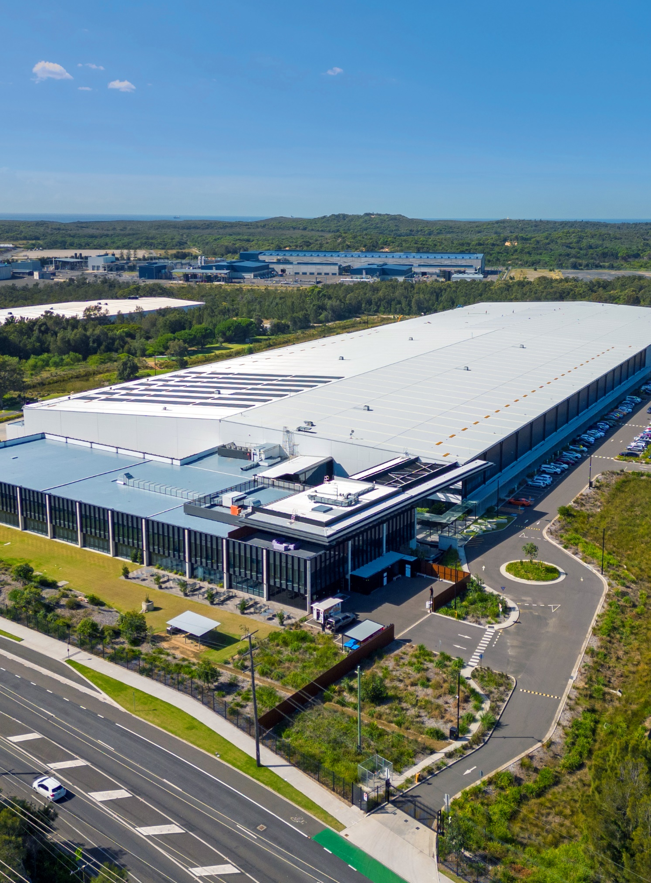

Thank you
for your time and participation today

