Slide 1

Azure Virtual Desktop
Power hybrid work and your AI readiness
Secure, flexible access to desktops and apps from anywhere

Slide 2
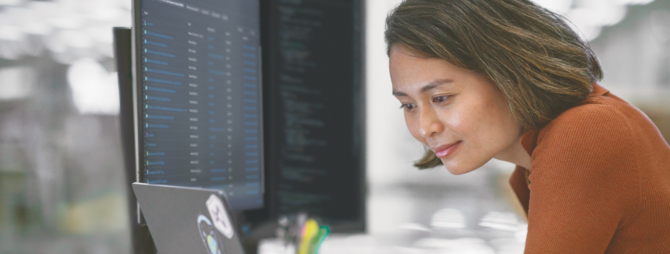
Power hybrid work and your AI readiness
Hybrid work is locked in
98% of workers want to work remotely at least some of the time¹ and 82% of employers expect it to continue.² At the same time 88% of Australian businesses and 90% in NZ intend to invest in AI in the coming year.³
The challenge: How do you support flexible work from anywhere, maintain security and prepare your infrastructure for AI – all while reducing IT complexity and cost?
Meet Azure Virtual Desktop (AVD)
AVD is Microsoft’s cloud-based desktop virtualisation service. It delivers secure access to Windows desktops and applications from anywhere, on any device.
You likely already have it: Your existing Microsoft 365 Business Premium, E3 and E5 subscriptions include AVD – you’re simply activating software you already own. It’s also simple to migrate from other systems like Citrix, VMware or Remote Desktop Services.
AI could add $115 billion to Australia’s GDP by 2030, with 70% of that gain coming from greater productivity.”
– Steven Worrall, former Managing Director, Microsoft ANZ
⁴

Slide 3


Built for hybrid work
Secure access from anywhere
Zero Trust security protects your data whether teams work from home, cafes or onsite.
Reduced IT complexity
Runs in the cloud, eliminating physical infrastructure and complex VPN setup.
Enterprise-grade security
Data stays in the cloud, not on devices. Built-in compliance with industry standards.
Scalability you control
Add or remove users in minutes. Pay only for what you use.

Slide 4

Building the foundation for AI
As organisations prepare for AI, many face infrastructure limitations – siloed data, legacy applications and insufficient computing power. AVD is your first AI building block:
Centralised in the cloud
Desktops, applications and data in one Azure platform, giving AI tools the access they need.
Scalable infrastructure
Add processing power on demand to support hybrid flexibility and growing AI workloads.
Security built in
Zero Trust security protects desktops and AI applications as your capabilities grow.
Cloud-native advantage
Add new capabilities including AI without physical infrastructure limitations.
Benefits that scale with your business
Small
(25-100 employees)
Simple, affordable remote work without the complexity of traditional VDI.
Save up to 40% compared
to on-premises VDI
Medium
(100-300 employees)
Hybrid flexibility with enterprise-grade control as you expand.
Improve IT efficiency by
30% while reducing complexity
Large
(300+ employees)
Modernise and unify your virtual desktop platform at scale.
Reduce total VDI costs by 30-50% and improve
uptime to 99.95%
AVD in action
Healthcare
Medical centres provide instant, secure access for permanent staff and visiting specialists – meeting HIPAA compliance while gaining valuable patient care time.
Education
Schools create secure profiles for teachers, relief staff and students – rapid and flexible deployment without physical setup, protecting sensitive data across all devices.
Manufacturing
Factories enable role-based access on shared terminals – protecting IP and operational data while supporting dynamic shifts, sites and workforce needs.

Slide 5
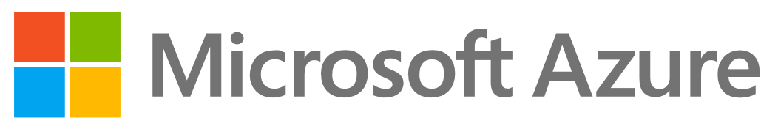
We support you at every step
From assessment and planning through to deployment to ongoing support, we help you implement AVD and prepare your infrastructure for the future.
About <partner name>
[Add your partner description – a few sentences about your expertise, approach or credentials]
Get in touch [Contact Name, Title] [Email] [Phone]
Learn more at: [Website]
References:
Forbes: Top Remote Work Statistics And Trends, 2023
Human Resources Director (HRD): Hybrid work enters ‘stabilisation phase’ in Australia, 2025
Tech Research Asia, Dicker Data and Microsoft: The Strategic Partner Shift, 2025
AFR, Economic summit can be AI’s ‘Team Australia’ moment, 2025

